Slide 1

The Republic of North Macedonia
SKOPJE from 29/8/2021-14/9/2021
Dissemination Report – Staff Mobility for Training
Tonća Jukić, Assoc. Prof., PhD
Department of Pedagogy
Faculty of Humanities and Social Sciences
University of Split

Slide 2

The Faculty of Philosophy in Skopje was founded in 1920.
Today, the Faculty of Philosophy is a modern, interdisciplinary faculty consisting of 12 institutes of humanities and social sciences.
Study programs offer BA, MA and PhD degrees in the following disciplines: philosophy, history, pedagogy, sociology, classical studies, history of art and archeology, psychology, social work and social policy, special education and rehabilitation, security defense and peace, gender studies, and family studies.
http://fzf.ukim.edu.mk/
The Institute of Pedagogy is one of the oldest institutes at the Faculty of Philosophy in Skopje, with a focus on teaching and academic research in the study of pedagogy. At the Institute of Pedagogy, pedagogy is taught at undergraduate, post-graduate and doctoral level.

Slide 3
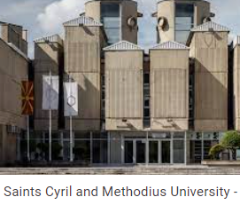
Overall objectives of the mobility for training at the Faculty of Philosophy in Skopje:
to get insight into different possibilities of interactive teaching and students’ self-assessment, assesssment and evaluation
to deepen insight into the curriculum development strategies in higher education in North Macedonia
to elaborate joined scientific project in the field of pedagogy and teaching methodology

Slide 4
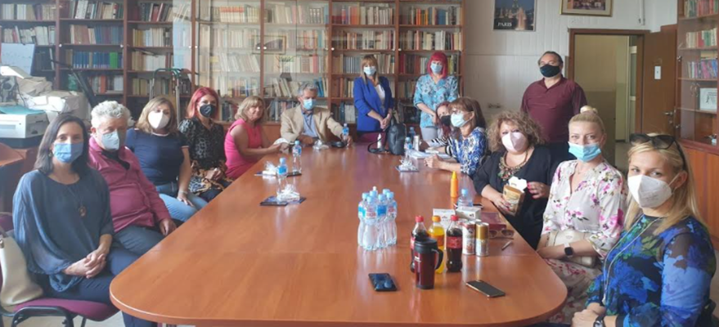
Activities and results (i)
At the Faculty of Philosophy in Skopje:
I had meetings with:
  Dean Ratko Duev, full professor, PhD
  Vice Dean for Research and International Cooperation Maja Gerovska Mitev, full professor, PhD,
  Elizabeta Tomevska Ilievska, full professor, PhD (head of the Institute of Pedagogy),
  colleagues from the Institute of Pedagogy (http://fzf.ukim.edu.mk/en/institute-of-pedagogy/)
  colleagues from the Institute of Sociology (http://fzf.ukim.edu.mk/en/institute-of-sociology/)
I discussed with colleages at both institutes different topics regarding differences and similarities between two faculties, pedagogical and social issues we faced such as education and teaching in the period of pandemic, possibilies of mobility, etc.

Slide 5
Activities and results (ii)
At the Faculty of Philosophy in Skopje:
I also discussed with colleagues at the Institute of Pedagogy possible future aspects of cooperation such as mobility, conferences, summer schools programmes, research work, projects, etc.
During the stay, I worked on collaboration between two faculties (especially two departments of pedagogy) and on possible joined research activities in the fields of pedagogy and teaching methodology.
Overall findings:
at the Institute of Pedagogy
  modern teaching and research approaches are used as well as different modern aproaches to assessment, self-assesment and evaluation
  contemporary competency-based and student-centered approach to teaching and learning is used
  we have started on sketching joined scientific project in the field of pedagogy

Slide 6
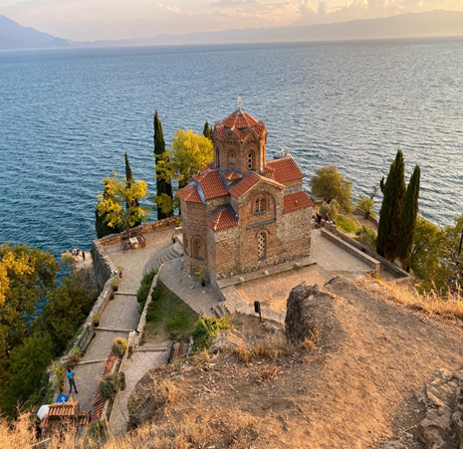
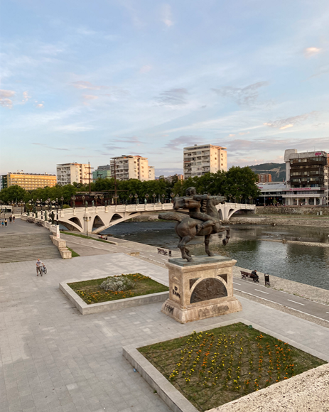
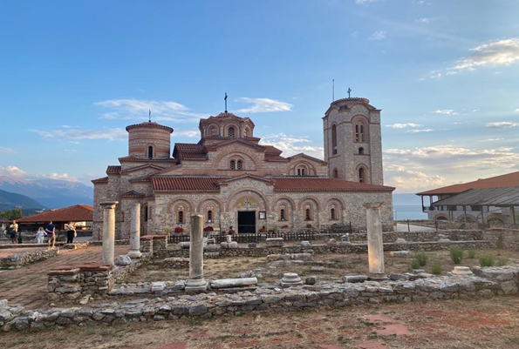
I enjoyed in organized visiting tours in Skopje, Ohrid and Gevgelija and was fascinated by varieties of cultures and traditions of the Republic of North Macedonia.
Colleagues from the Faculty of Philosophy in Skopje are very professional, collegial and up-to-date. They are friendly and welcoming. I fully reccomend this institution for cooperation.

